Slide 1
Airbnb Data Analysis and Visualization
Hannah Shelton
Zach Mason
Nic Mallett

Slide 2
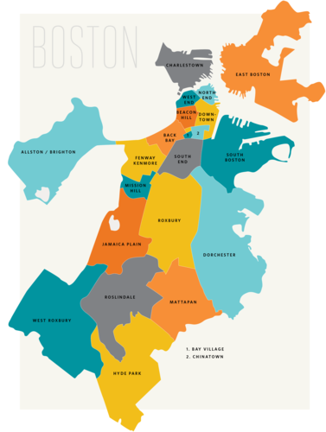
What neighbourhood in Boston best serves a family on vacation?
Insight into the 26 Boston Area Neighborhoods
Average Price
Ratings
Accommodations
Worked to visualize the Airbnb situation in the Greater Boston Area
Planning a vacation or extended getaway
Potential Investors
Notes:
In recent years, Airbnb has grown in popularity with use cases ranging from a romantic weekend getaway to a month long work retreat. With that, the idea to invest in a secondary home for rental purposes has as well. Our project will dive into the home share marketplace located in Boston, MA. focusing on current Airbnb listings. We will use datasets to determine average listing rates, what people like about the property, which homes have higher ratings, and the amount of Airbnb’s in each neighbourhood. We hope that once completed, this project will provide value to customers and investors by sharing knowledge on how they can start a successful home sharing business or book a quality stay for their family vacation.

Slide 3

Methodology
https://insideairbnb.com/get-the-data/
listings.csv.gz
neighbourhoods.geojson
Obtain the data
Clean data in by removing columns we did not need and deleting null values
Map visualizations with Leaflet and GeoJSON
Bokeh library used to plot the data

Slide 4
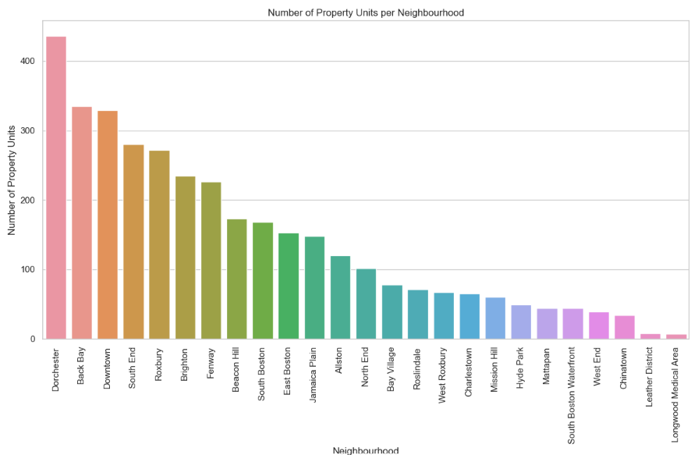
Notes:
Here we just wanted to get an idea of how many residences were located in each neighborhood giving you idea of where you’d be more likely to find a place.

Slide 5
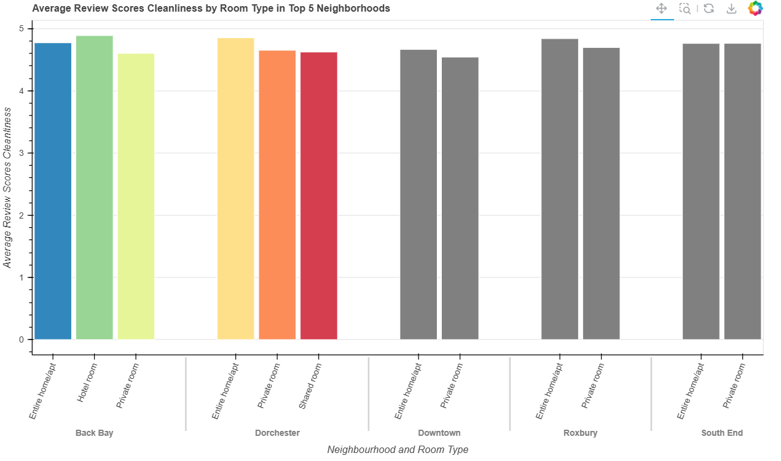
Notes:
Here we broke down the top 5 neighborhoods by number of units into room type and compared that to cleanliness. We chose to use cleanliness as a focal point for most of our visualizations as its a extremely important factor for families. It doesn’t seem like you can go wrong in any of these neighborhoods if cleanliness is paramount. We chose to leave the last three grey to signify there are fewer options available when looking there. From an investors standpoint if you had an untidy place it seems like you would be in the minority of listings, not where you want to be!

Slide 6
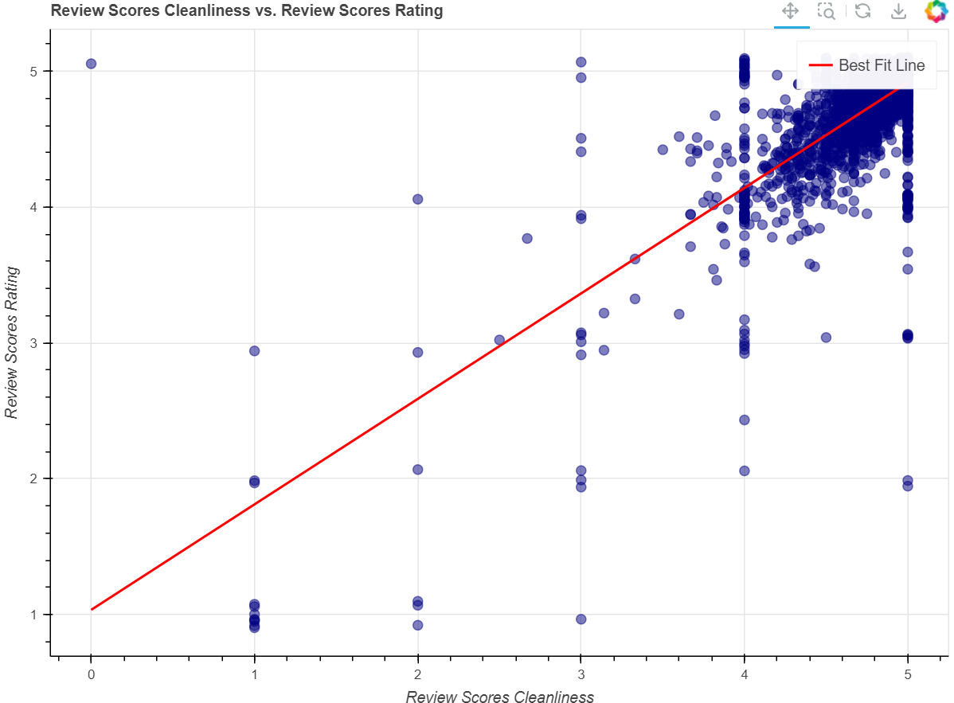
Clean is key
Review Scores by Rating
Cleanliness Rating
Notes:
Here we notice the effect of a clean place…people like it more! If you want to get a higher rating it would benefit you to invest in a cleaning service spruce it up before your next guests.
When investing in a airbnb make sure you consider the costs to include some sort of cleaning service whether that’s your own time or money.

Slide 7
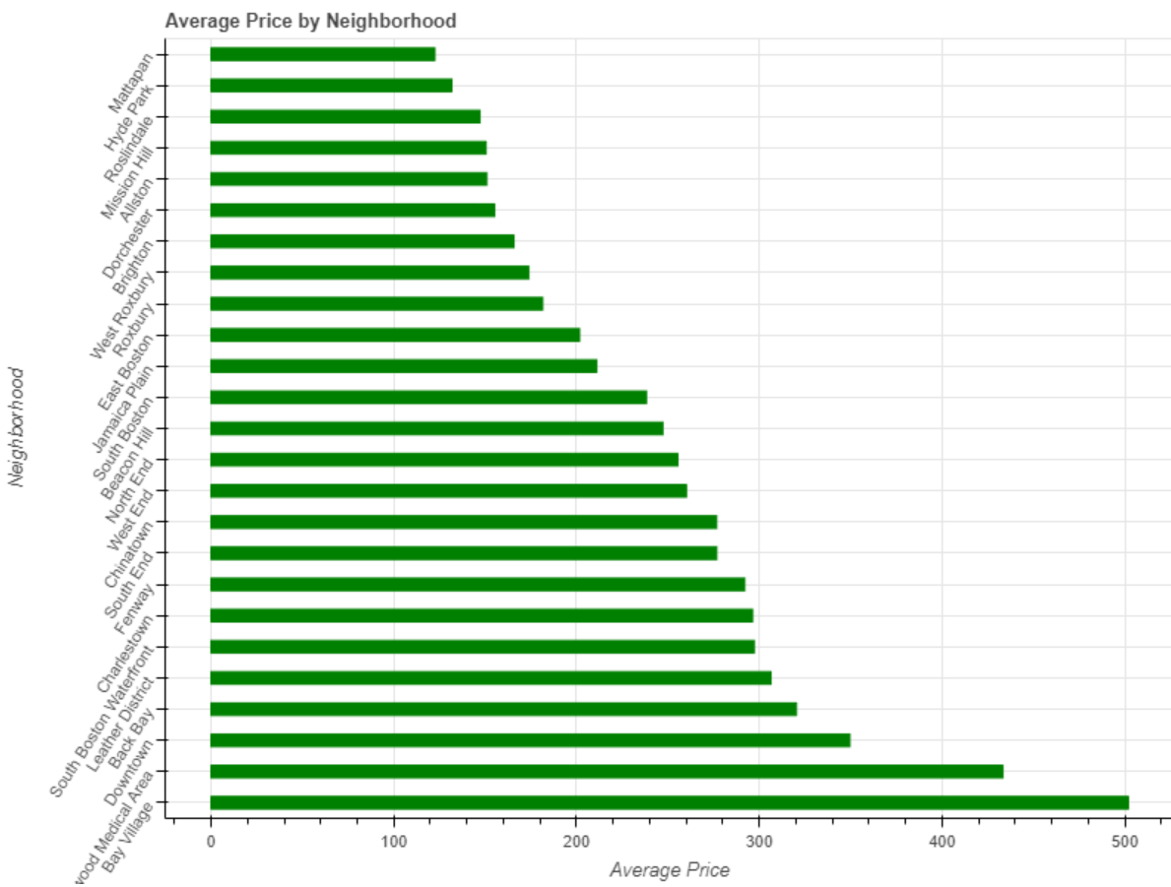
Average Price by Neighbourhood
Neighbourhood
Average Price per Night
Notes:
Here we have a chart showing the avg price of a listing by neighborhood. We have also included some arrows that point out the top 5 neighborhoods based on listing volume. If we relate this to our previous graph we can tell that you don’t really need to pay more to have a more quality stay. As for me, I would never be paying $250/night per room but thats me! But for Boston and travelers it is good there are a range of stays for different financial levels. It would be interesting to look at the property types in each neighborhood and group them based on cost. This could be worthwhile for investors who want to be competitively priced or customers looking for a good deal in a specific location.

Slide 8
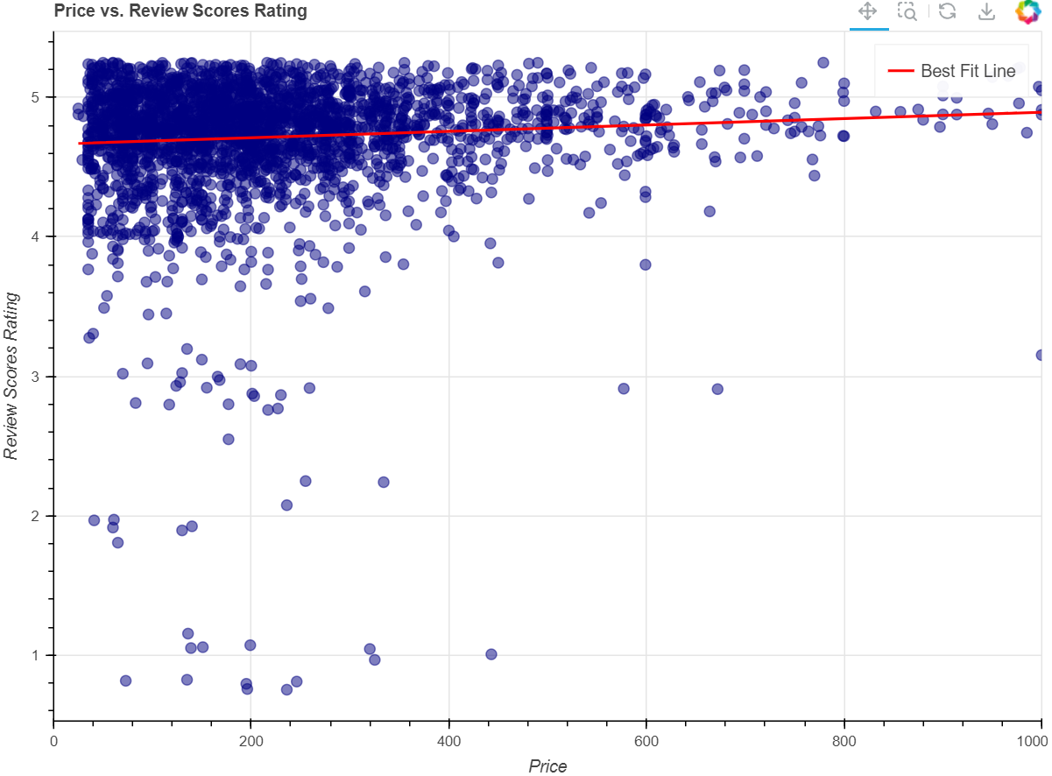
Price by Review Rating
Most times people see a higher price and think it results in a better product.
Here we see that regardless of the price people tend to enjoy their stays.
Review Score Rating
Price
Notes:
The graph shown here with a line of best fit shows that regardless of the price people tend to rate their stay high. It also serves as a reminder that sometimes the more expensive home might not be “all that”. We realize price isn’t the only thing that determines your rating but if you paid highly for a not so clean stay you might think the host deserves a 2 star.

Slide 9
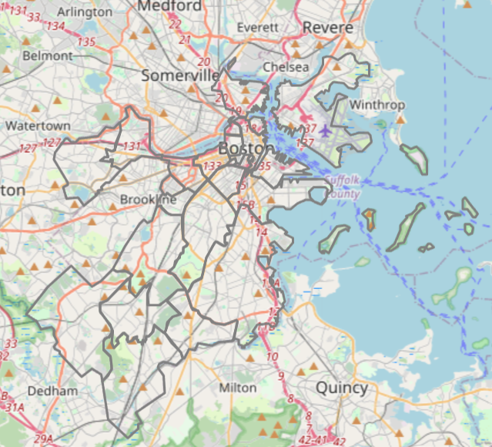
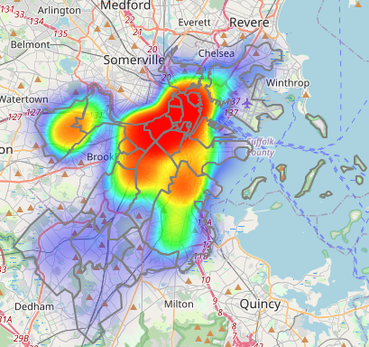
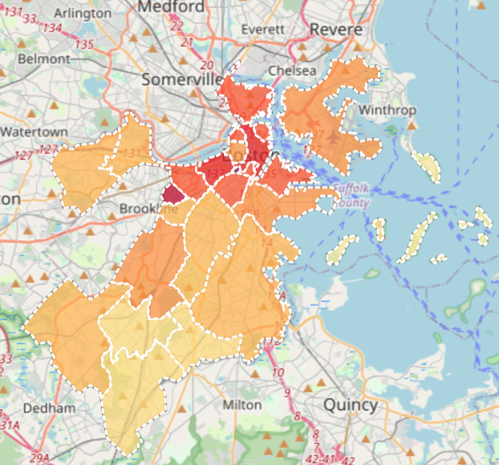
Base Maps
Street Map
Heat Map
Choropleth Map

Slide 10
Thank you!

